Slide 1
ALCOHOL AND OTHER DRUGS OF ABUSE
OPIO JOEL
G COHES

Slide 2
Objectives
By the end of this discussion, the student should be able to
Appreciate that alcohol is a commonly abused substance
List at least 5 other substances of abuse and their classes (lecture 2)
Describe the aetiology, clinical presentation and complications of substance abuse

Slide 3
Outline
Introduction
Epidemiology
Aetiology
Clinical presentation
Complications

Slide 4
Introduction
Alcohol is the most abused drug on earth
Its use has been documented for thousands of years
It is mentioned in ancient texts like the Bible, Koran , Egyptian hieroglyphs, Chinese texts
It is favoured for its unique relaxing and sedating properties

Slide 5
Introduction
It is a small molecule prepared from fermenting sugars
It is commonly served at social events because it fosters social interaction.
Served at parties, funerals, meals and other social occasions
Occasionally used with other substances

Slide 6
Epidemiology
Uganda ranked among high alcohol users in the world
19.7 litres of pure ethanol per adult per year (WHO Alcohol 2004)
54.9% and 27.9%women to men report lifetime abstinence
10.0% and 1.5% men to women alcohol use disorders

Slide 7
Epidemiology
6.13 litres of pure alcohol consumed pa
Highest use in northern hemisphere, also Argentina, Australia, New Zealand
Lowest in North Africa, Southern Asia
Alcohol use usually associated with the use of other drugs

Slide 8
Etiology
Alcohol is a small molecule. OH group is responsible for its properties
Consuming the drugs is soon followed by a euphoric effect, excitement, feeling at peace or at ease, talkativeness, restlessness
But with increasing levels; slurred speech, poor coordination and balance, sleepiness, coma and then death

Slide 9
Etiology
Follow the Biopsychosocial model
Availability, social acceptance, peer pressure.
Personality
Individual biology, family history

Slide 10
Etiology
Natural rewards Reward chemical
Food
Water Dopamine
Sex
Other rewards
Nature

Slide 11
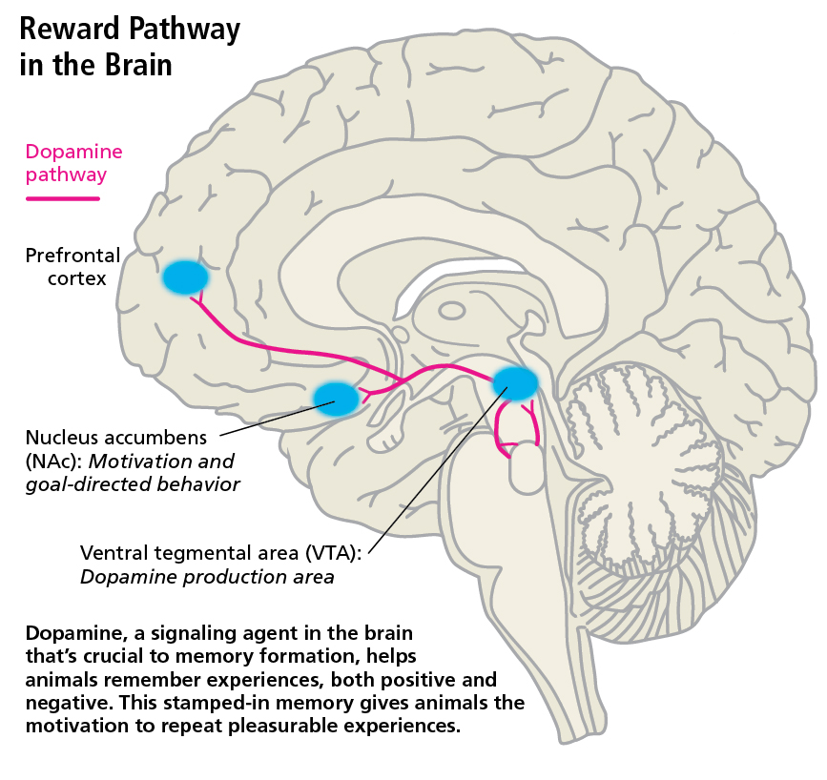

Slide 12
Etiology
Reward pathway
Special area in the brain that controls behaviour associated with ‘reward’
Release of dopamine results in a ‘feel good’ sensation
Animal repeats behaviour that feels good
Other activities include food, water, sex

Slide 13
Clinical presentation
Person with substance use disorder can present at any point with health problems that maybe directly or indirectly related to substance abuse.

Slide 14
Clinical presentation
1. Alcohol use disorder
2. Alcohol Intoxication
3. Alcohol withdrawal
4. Alcohol induced mental disorder
Other important terms
Alcohol tolerance
Alcohol dependence

Slide 15
Alcohol Use disorder
Maladaptive pattern of substance use leading to clinically significant impairment
Recurrent substance use resulting in a failure to fulfil major role obligations at work, school, or home
Recurrent substance use in situations in which it is physically hazardous
Continued substance use despite having persistent or recurrent social or interpersonal problems

Slide 16
Alcohol Use disorder
Tolerance
The substance is often taken in larger amounts or over a longer period than was intended
Withdrawal
Craving
Important social, occupational, or recreational activities are given up or reduced because of substance use
There is a persistent desire or unsuccessful efforts to cut down or control substance use
A great deal of time is spent in alcohol related activities

Slide 17
Alcohol intoxication
The development of a reversible substance-specific syndrome due to recent ingestion of (or exposure to) a substance..
Clinically significant maladaptive behavioral or psychological changes that.. develop during or shortly after use of the substance.
The symptoms are not due to a general medical condition and are not better accounted for by another mental disorder

Slide 18
Alcohol withdrawal
The development of a substance-specific syndrome due to the cessation of (or reduction in) substance use that has been heavy and prolonged.
The substance-specific syndrome causes clinically significant distress or impairment in social, occupational, or other important areas of functioning.
The symptoms are not due to a general medical condition and are not better accounted for by another mental disorder

Slide 19
Tolerance
Tolerance, is defined by either of the following:
1. A need for markedly increased amounts of the substance to achieve intoxication or desired effect
2. Markedly diminished effect with continued use of the same amount of the substance

Slide 20
Dependence
Also know as ‘alcoholism’
Continued or repeated use of the substance leading to behavioural dependence, physiological dependence and psychological dependence.
Person cannot function well without the drug or substance

Slide 21
Alcohol induced mental disorder
Alcohol psychosis;
A cluster of psychotic phenomena that occur during or following alcohol use but that are not explained on the basis of acute intoxication alone and do not form part of a withdrawal state

Slide 22
Complications
Neuropsychiatric disorders
Gastrointestinal diseases
Cancer
Intentional injuries (e.g. suicide)
Unintentional injuries
Cardiovascular disease
Foetal alcohol syndrome
Diabetes mellitus

Slide 23
Other complications of alcohol
Poverty
Domestic violence
Unemployment
HIV/AIDS
Conflict with the law

Slide 24
Investigations
Social
Psychological
Biological

Slide 25
Social investigation findings
Relationship problems; separation and divorce, other family discord
Financial problems; overdue unpaid loans
Employment problems; lost jobs, frequent warning, underperformance
School problems
Problems with the law

Slide 26
Psychological findings
Poor coping mechanisms and skills
Interpersonal problems
Poor intrapersonal understanding
Signs and symptoms of depression
Signs and symptoms of anxiety
Poor memory
Poor concentration and attention

Slide 27
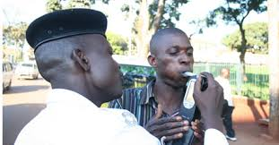

Slide 28
Biological findings
1. Ethanol levels
Blood, urine or breath alcohol levels
Levels >1.5% with gross intoxication or 3% at any time points to alcoholism
Half life of < than 24hours

Slide 29
.
2.Gamma Glutamyltransferase (GGT)
Half life of 2-3weeks
Maybe elevated to several times of the upper limit
3. Mean corpsular volume (MCV) - increases
Half life of 3 months
4. Aspartate Aminotransferase (AST) - increases
Half life 2-3 weeks

Slide 30
5. Alanine Aminotransferase (ALT)
Half life of 2-3 weeks
6. Carbohydrate-deficient transferrin
Highly specific for alcohol

Slide 31
Social treatment
Occupation
Family and social support
Adjusting the environment eg shifting away from a ‘heavy alcohol area’
Rehabilitation

Slide 32
Psychological treatment
Cognitive behavioural therapy
Motivational interviewing
Brief intervention
Teach coping skills
Teach problem solving skills
Treat psychiatric illnesses like depression, anxiety where present

Slide 33
Biological treatment
Detoxication phase
Benzodiazepines e.g. Diazepam, chlordiazepoxide
Other drugs
Disulfiram
Acamprosate
Naltrexone
Topiramate

